Slide 1


Programming Project 03
Christine Robinson, Francèl Lamprecht, Regina Wehler

Slide 2
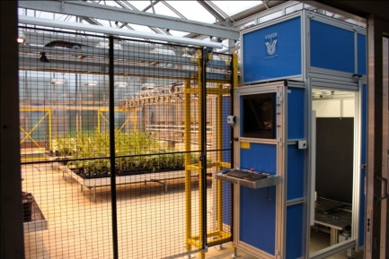
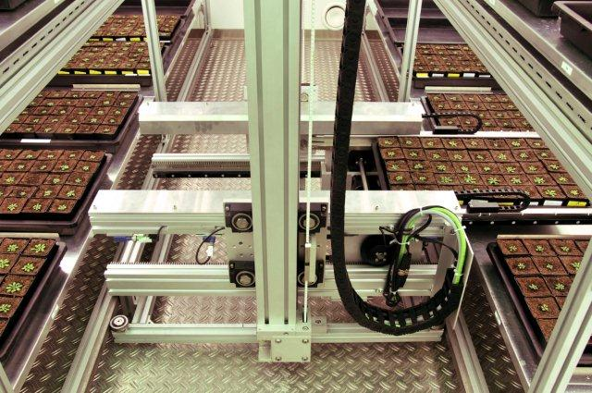
Plant Phenotyping
Main bottleneck in plant research and breeding is the phenotyping capability
Required: high-throughput phenotyping with non-invasive methods to screen root and shoot phenotypes
Solution: robotic driven greenhouses
Examples at the Forschungszentrum Jülich:
Both greenhouses are equipped with robots that transport plants to imaging stations
SCREEN House
GROWSCREEN chamber

Slide 3
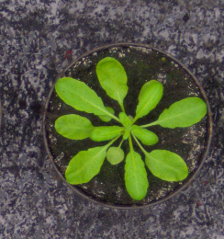
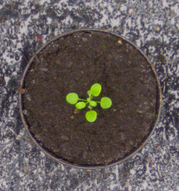
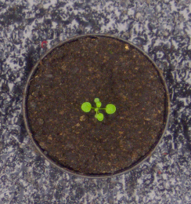
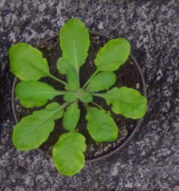
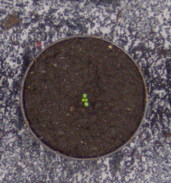
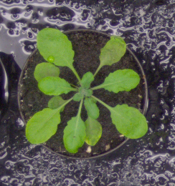
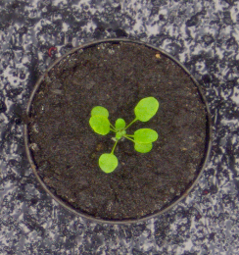
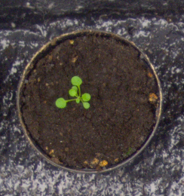
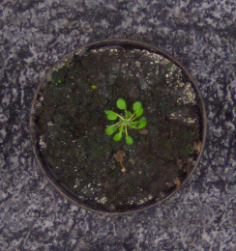
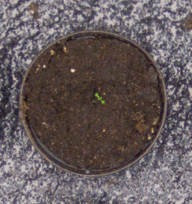
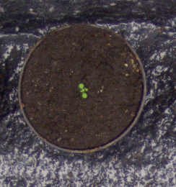
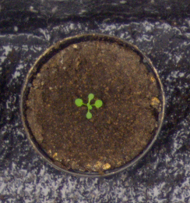
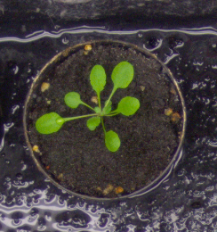
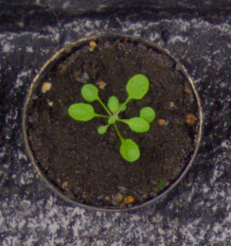
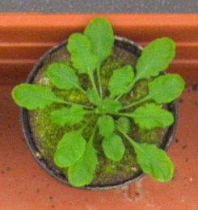
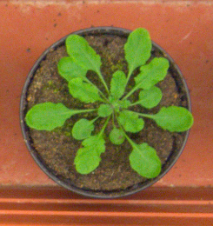
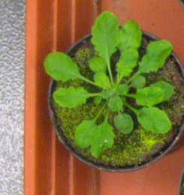
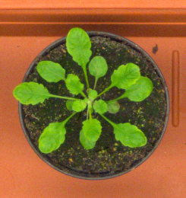
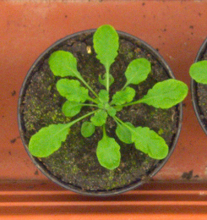
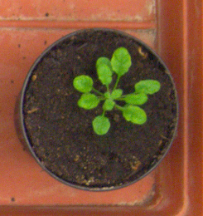
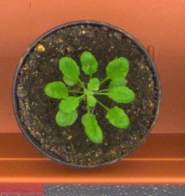
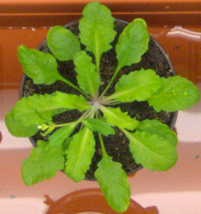
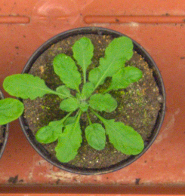
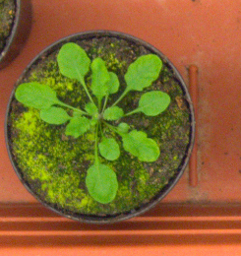
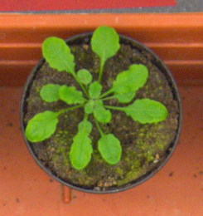
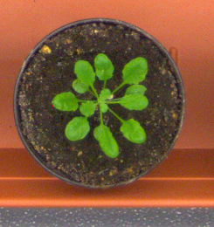
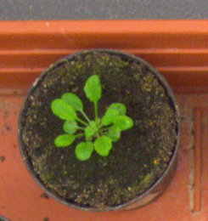
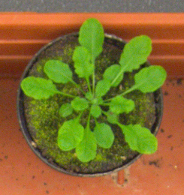
Computer Science Part
➔ Automated analysis of automatically acquired plant images

Slide 4


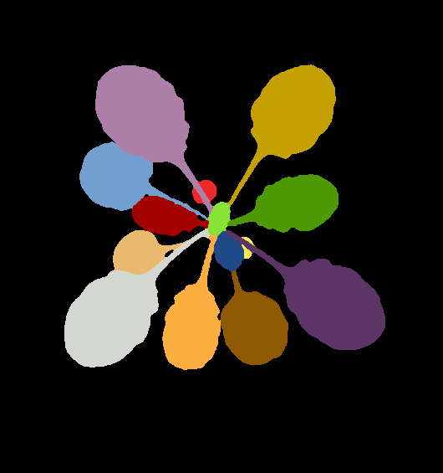
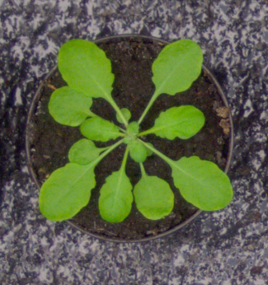
Goal of this Project
Develop a simple approach for plant classification from top view photos of seedlings
Two main parts:
Image Analysis with Fiji in Java
Explorative Data Analysis with Python in Jupyter Notebooks
Data Sets: training sets from the Leaf Segmentation and Counting Challenges of the International Plant Phenotyping Network which include wild type and mutant plants

Slide 5



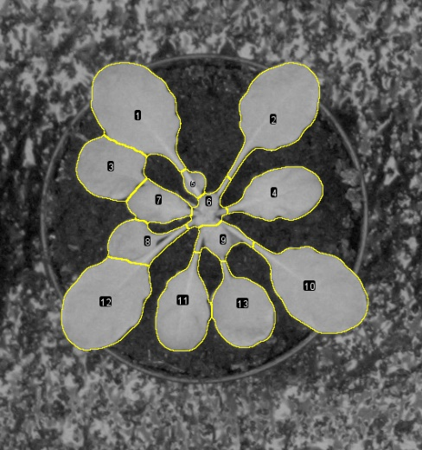
Image Analysis Pipeline
1.) RGB input image
2.) Classification
3.) Leaf Identification
4.) Leaf Analysis

Slide 6
Image Analysis Pipeline
Trainable Weka
Segmentation
1.) RGB input image
2.) Classification
3.) Leaf Identification
4.) Leaf Analysis

Slide 7
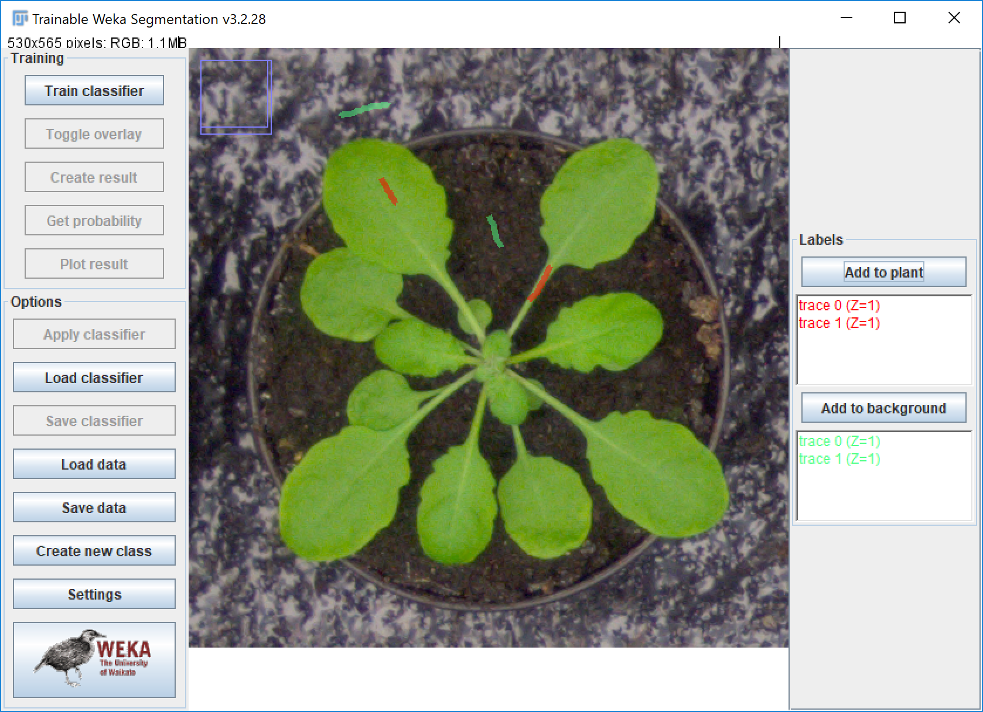
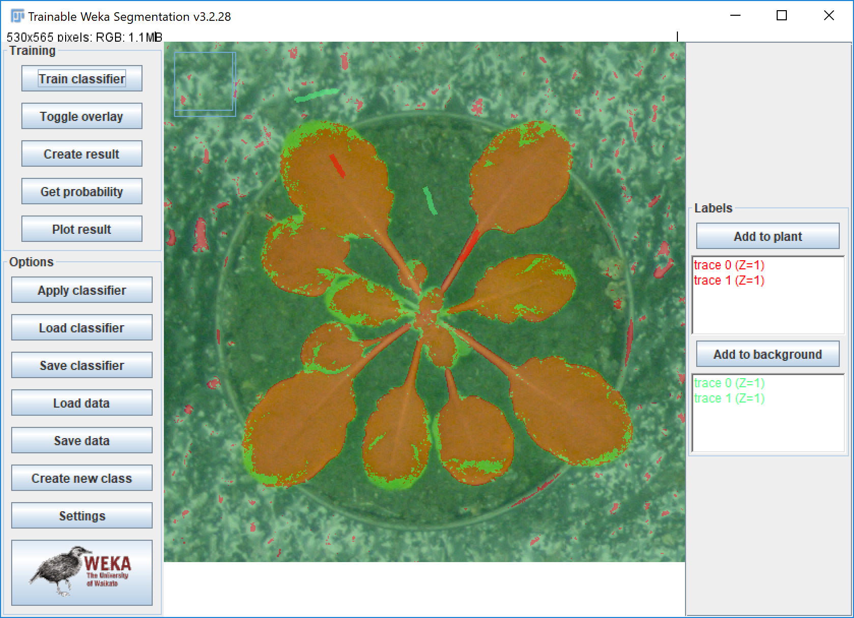
Trainable Weka Segmentation
Training a FastRandomForest classifier in the Weka GUI
Using 6 diverse photos

Slide 8
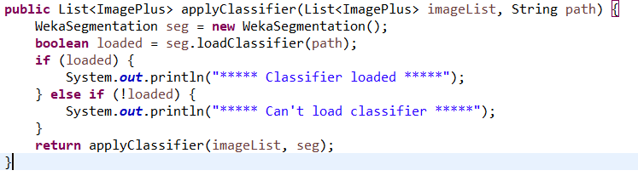
Trainable Weka Segmentation Code
Applies a trained classifier to a list of RGB images.
Loads the classifier from a .model file
Returns classified image list

Slide 9
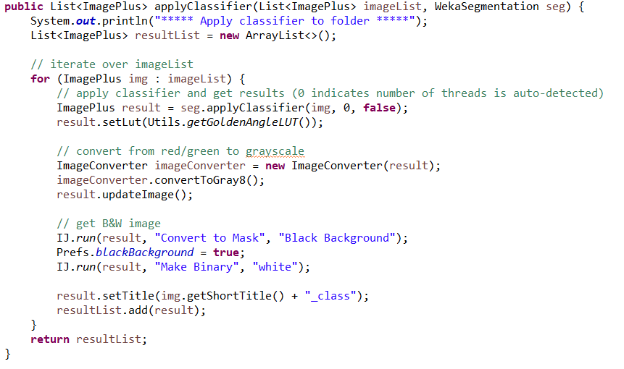
Trainable Weka Segmentation Code

Slide 10
Image Analysis Pipeline
Single Leaf
Segmentation
1.) RGB input image
2.) Classification
3.) Leaf Identification
4.) Leaf Analysis

Slide 11
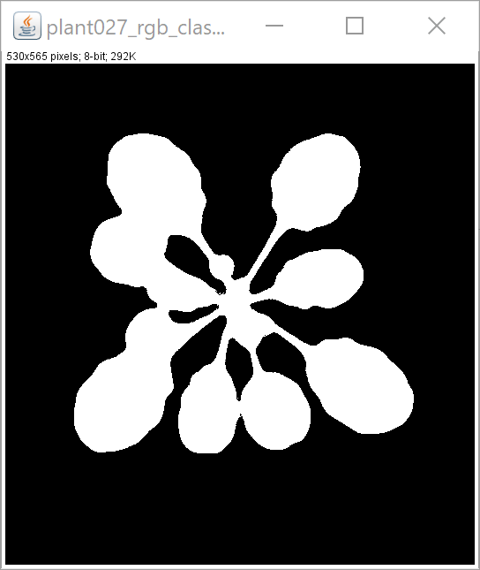
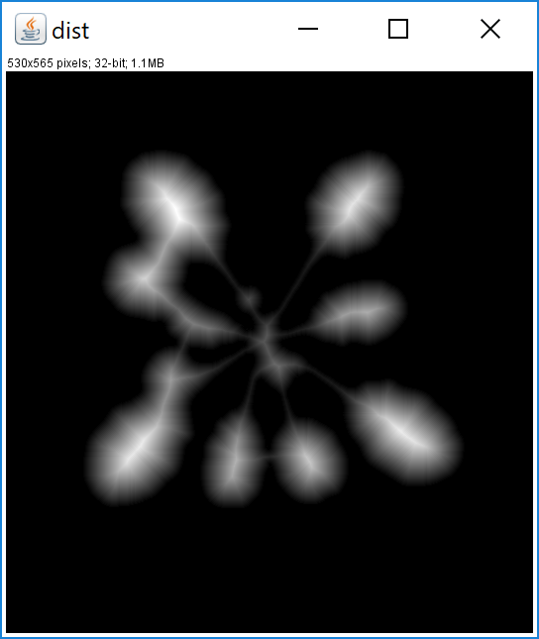
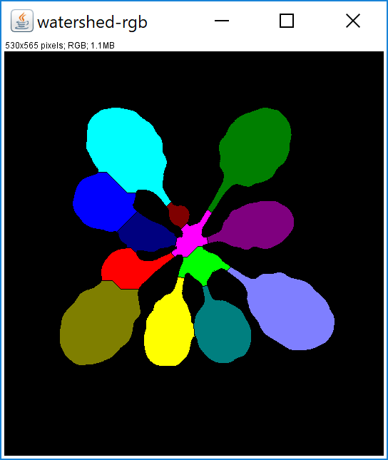
Watershed Segmentation
1
2
input: binary class image
step 1: compute distance map, i.e. compute for each white pixel the chamfer distance to the nearest background (black) pixel
step 2: draw a line (= separate two objects) where two „watersheds“ meet
output: binary image with added watershed lines
Notes:
* Computes the distance map from a binary image processor, by specifying * weights and normalization. * Distance is computed for each foreground (white) pixel, as the chamfer * distance to the nearest background (black) pixel.

Slide 12
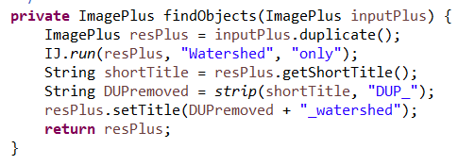
Watershed Segmentation Code
Applies the watershed algorithm to a binary input image and returns a binary output image with watershed lines:

Slide 13
Image Analysis Pipeline
1.) RGB input image
2.) Classification
Particle
Analyzer
3.) Leaf Identification
4.) Leaf Analysis

Slide 14
Particle Analyzer
using particle analyzer (Fiji) to measure properties of single objects (leaves)
do this for splitted red, green and blue channels
Particle Analyzer | Information (in CSV output)
Area | Size
Centroid | pos_x and pos_y
Shape descriptors | roundness
Integrated density | brightness_sum
Mean gray value | brightness_average
Bounding rectangle | width_to_height_ratio
Feret‘s diameter | feret_min, feret_max, feret_ratio

Slide 15
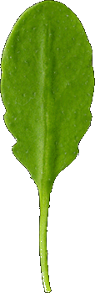
Particle Analyzer
using particle analyzer (Fiji) to measure properties of single objects (leaves)
do this for splitted red, green and blue channels
Width-to-height ratio vs. feret ratio
feret_min
height
feret_max
width

Slide 16
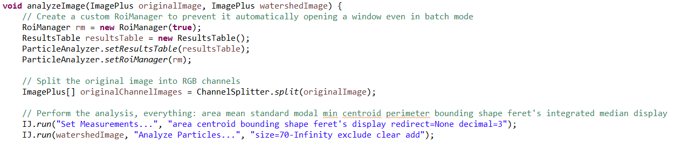
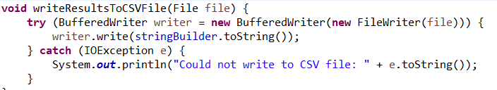
Particle Analyzer Code
Run the Fiji Particle Analyzer.
Iterate over every leaf.
Add measured data to a csv string.
Export data to a csv file.

Slide 17
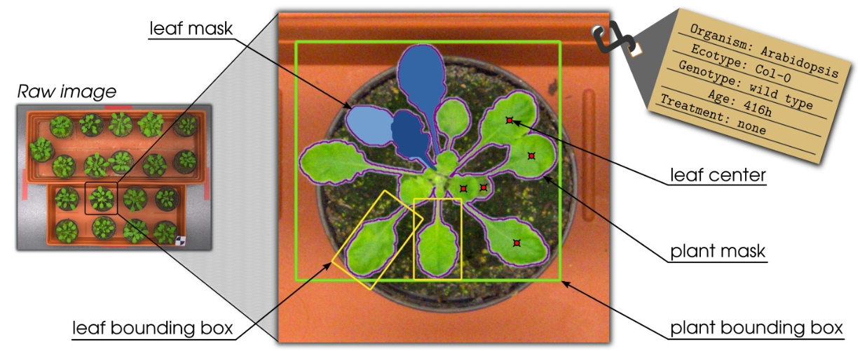
Explorative Data Analysis
Using pandas, seaborn, scipy, matplotlib in jupyter notebook
https://www.plant-phenotyping.org/datasets-home

Slide 18
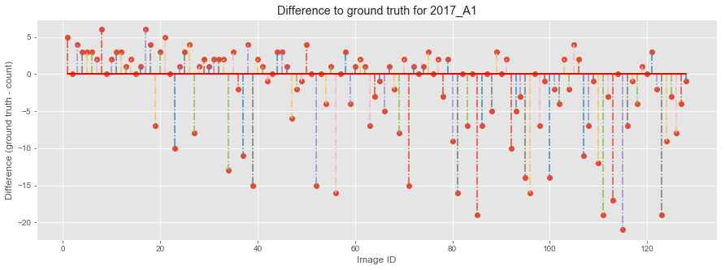
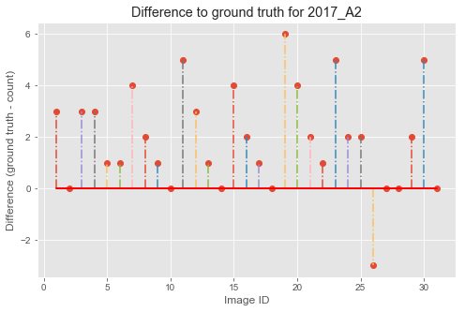
Comparison of leaf counts to ground truth
Root mean squared error:
A1: 6.72
A2: 2.74

Slide 19

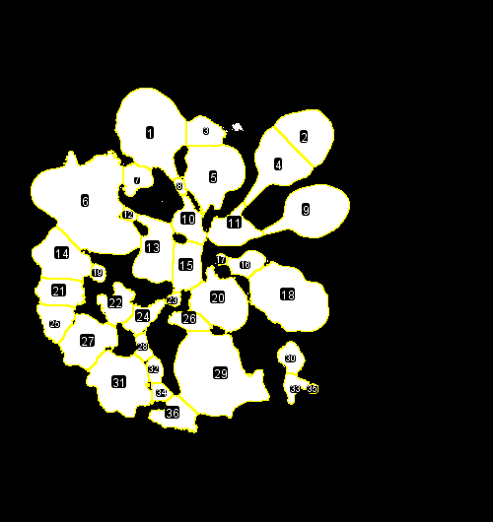
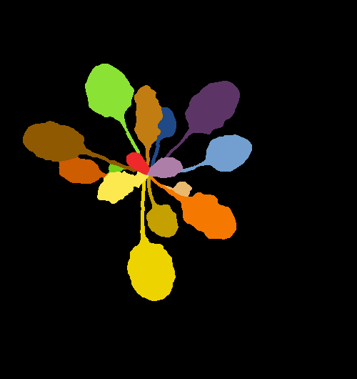
Bad performance of classifier with mossy plants
high root mean squared error for A1 dataset
trained classifier is not able to distinguish between moss and Arabidopsis
➔ high error rate in A1 dataset
Mossy input image
our classification
ground truth

Slide 20
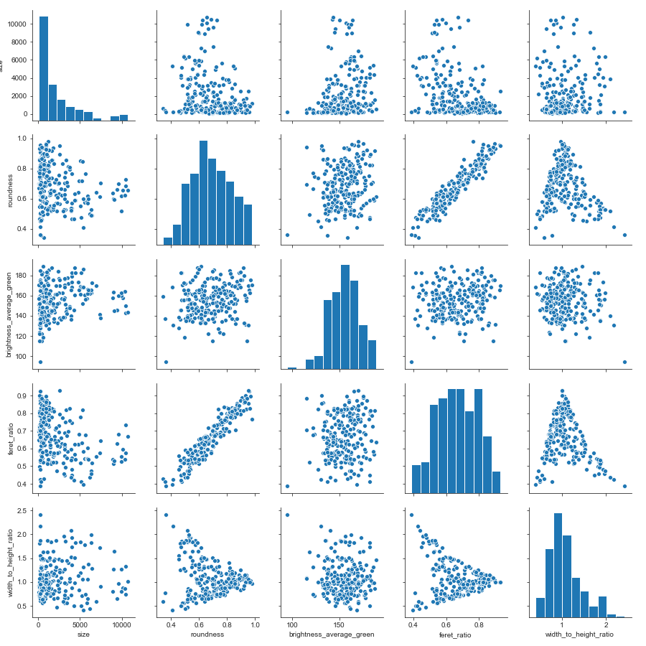
Data Analysis – Overview of A2 Dataset
Size
Roundness
average brightness of green
feret ratio
width to height ratio

Slide 21

Does the size of a leaf relate to its roundness?
Roundness
Size
No, size of a leaf and ist roundness are not correlated.

Slide 22

Does the size of a leaf relate to its color?
Brightness average green
Size
No, size of a leaf is not correlated to its average green brightness.

Slide 23

Is the number of leaves correlated to total area?
spearman =0.94; p=5.83e-14)
Total area
Number of leaves
The number of leaves per plant is correlated to the total plant area.

Slide 24
Comparison of A1 and A2 dataset
A1 dataset
 | size | roundness | brightness_average_green | feret_ratio | width_to_height_ratio
count | 2405 | 2405 | 2405 | 2405 | 2405
mean | 2300 | 0.683580 | 152.157593 | 0.661207 | 1.064216
std | 1920 | 0.131106 | 15.184565 | 0.113540 | 0.340877
A2 dataset
 | size | roundness | brightness_average_green | feret_ratio | width_to_height_ratio
count | 227 | 227 | 227 | 227 | 227
mean | 2193 | 0.688075 | 155.158879 | 0.666387 | 1.078050
std | 2512 | 0.140233 | 16.132569 | 0.124543 | 0.362589

Slide 25


Distribution of size in datasets
 | A1 | A2
count | 2405 | 227
mean | 2300.169231 | 2193.229075
std | 1919.748841 | 2512.367610
min | 70 | 88
25% | 736 | 430.5
50% | 1787 | 1155
75% | 3576 | 3160.5
max | 13488 | 10717
A1
A2
Kolmogorov-Smirnov test: p=8.31e-05
Since p<0.5, H₀ that distributions are same, is rejected

Slide 26
Summary
Our project’s successes:
By using Trainable Weka Segmentation (with a FastRandomForest classifier) we were mostly able to separate a plant from its background.
We successfully managed to identify separate leaves from a plant, with the Watershed algorithm, in order to successfully analyze the individual leaves.
By applying various statistical functions, we were able to perform an in-depth data analysis on our results and display them in a meaningful way.
What we can improve:
Improve the classifier to be able to identify moss as part of the background/noise and not as part of the image.

Slide 27
Thank you for your attention!
Questions?

